Slide 1

Effective Trial Presentation
BY: Judge Renee` A. Goble
Denver county court

Slide 2
Best Practices for Trial
Trial Process
Evidence
Objections
Record on Appeal
Jury Instructions

Slide 3
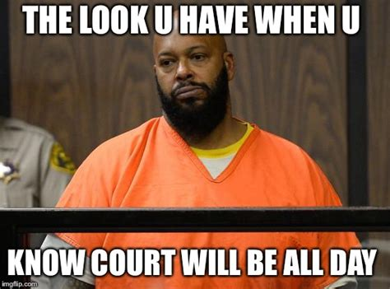
BE PREPARED
DON’T WASTE TIME
https://youtu.be/An2xQ2SrNSI?t=192

Slide 4
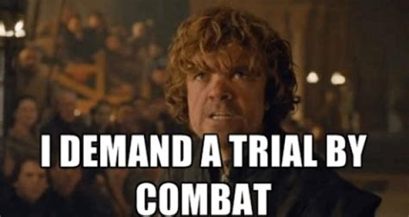
Trial is:
Opportunity to tell your/your client’s story
Give the Judge/Jury FACTS
Facts are applied the law and a decision is reached

Slide 5
Structure of a Trial
Opening = short summary of facts (3-5 min.)
Plaintiff goes first because they have the Burden of Proof = Preponderance of Evidence (more likely that not)
    Witnesses – subpoena power
    Exhibits – documents, pictures, video, text messages
Defendant goes second to present defense or counterclaims
    Witnesses – subpoena power
    Exhibits – documents, pictures, video, text messages
Closing = summary of facts as applied to law and explain what you/client wants and why you win. (5-10 min.)

Slide 6
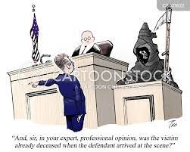
Direct Examination
https://youtu.be/t6jPu9NWeGQ?t=41
Let the witness testify
Ask open-ended questions:
  Who, what when, where, why, how, does, did?

Slide 7
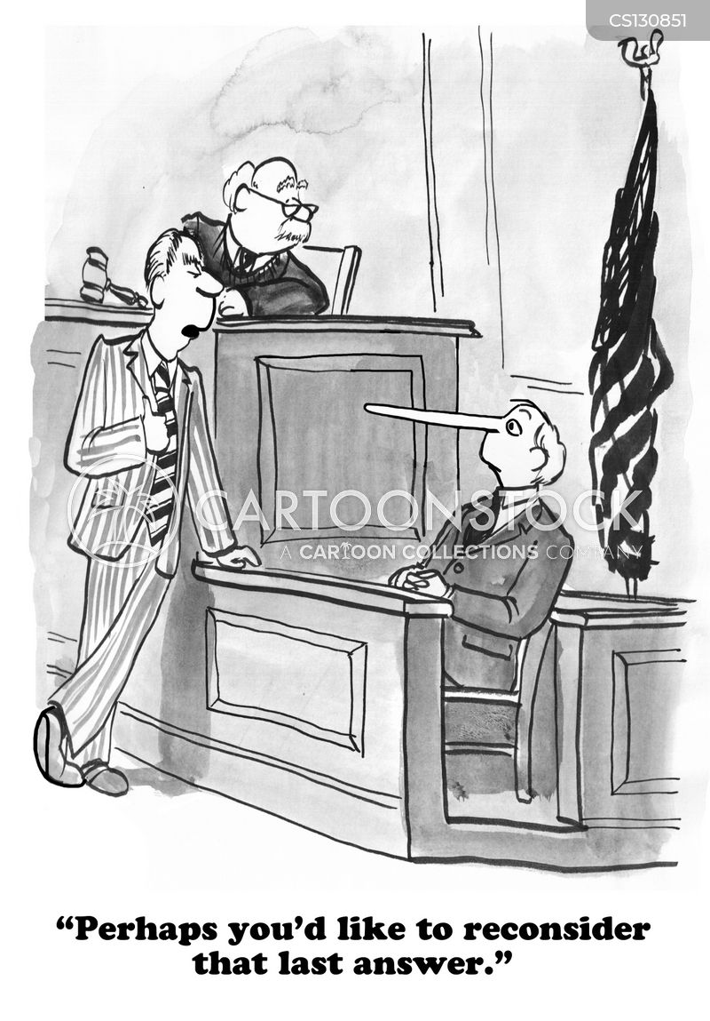
Cross Examination
https://youtu.be/02hSDh4hSpA?t=63
Short Leading Questions
Make them agree with you and say, “yes”
  Isn’t it true the sky is blue?
  You agree with me that pizza has cheese on it?
Get to the point!
Don’t repeat yourself

Slide 8
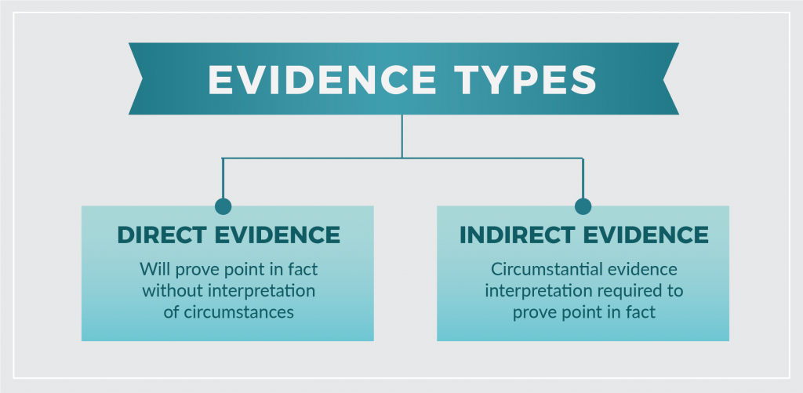
What is Evidence?
Testimonial – Direct and Cross examination
Demonstrative – illustrates witness testimony; ie. diagrams, pictures maps, video
Documentary – contracts, emails,
Real – i.e. weapon, clothing, car

Slide 9
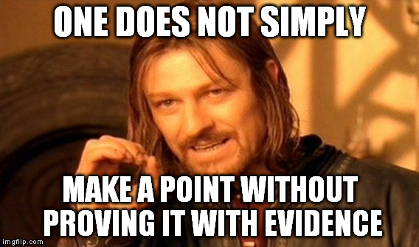
How do you get Evidence in the Record?
Colorado Rules of Evidence
Testimony
Exhibits
Stipulated Facts

Slide 10
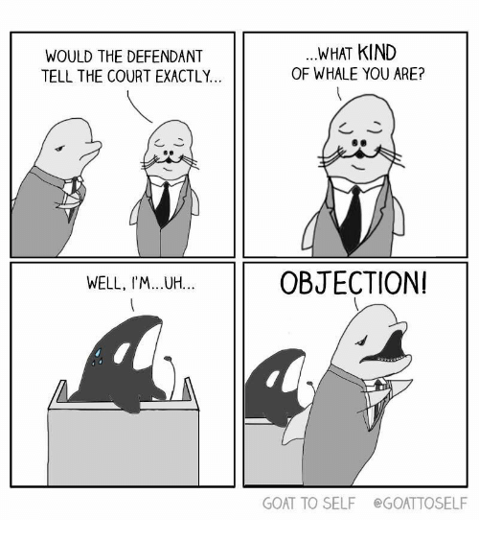
OBJECTION!
Types of Objections:
Relevance
Hearsay
Speculation
Compound
Vague
Authentication
Foundation
Leading
Asked & Answered

Slide 11
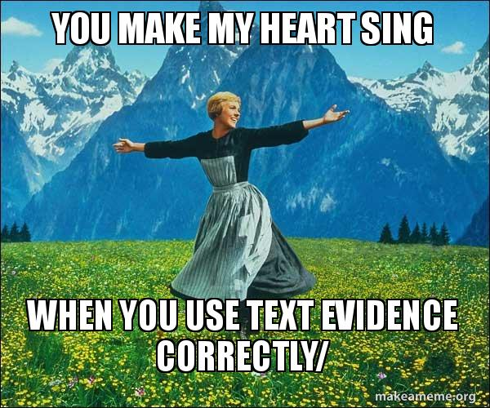
Bring copy of media on flash drive to play on computer
3 copies of all Exhibits
  Plaintiff uses #
  Defendant uses letters
Exhibits and disclosures are different things
Court must keep copies for the Record
Organize exhibits – I love binders

Slide 12
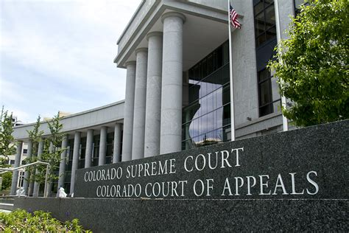

Record on Appeal
Speak into microphone clearly
Don’t talk over each other, especially the JUDGE!
Pause for objections and rulings on objections
Make sure all exhibits are entered, including video and flash drives

Slide 13
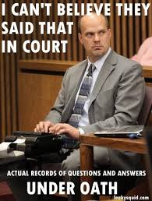

Slide 14
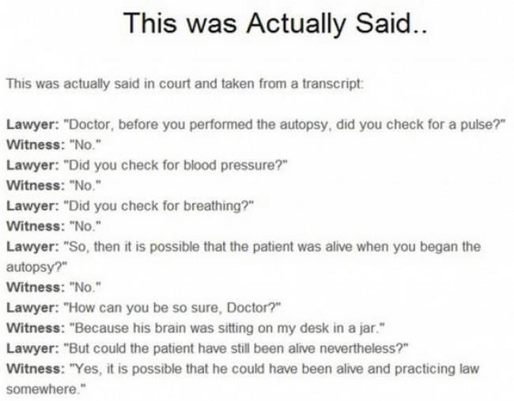

Slide 15
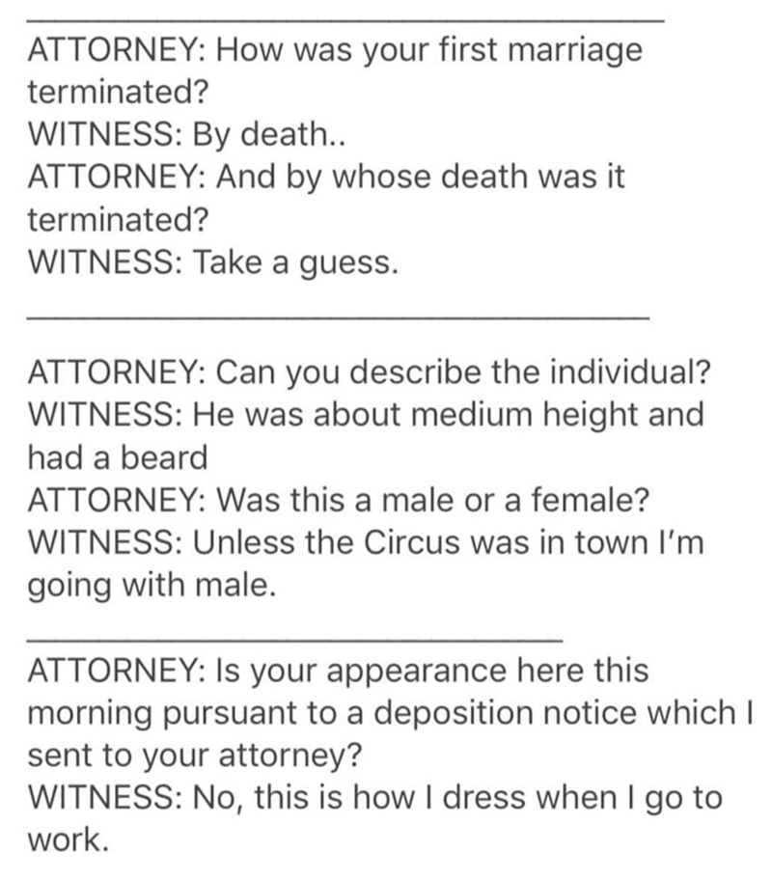

Slide 16
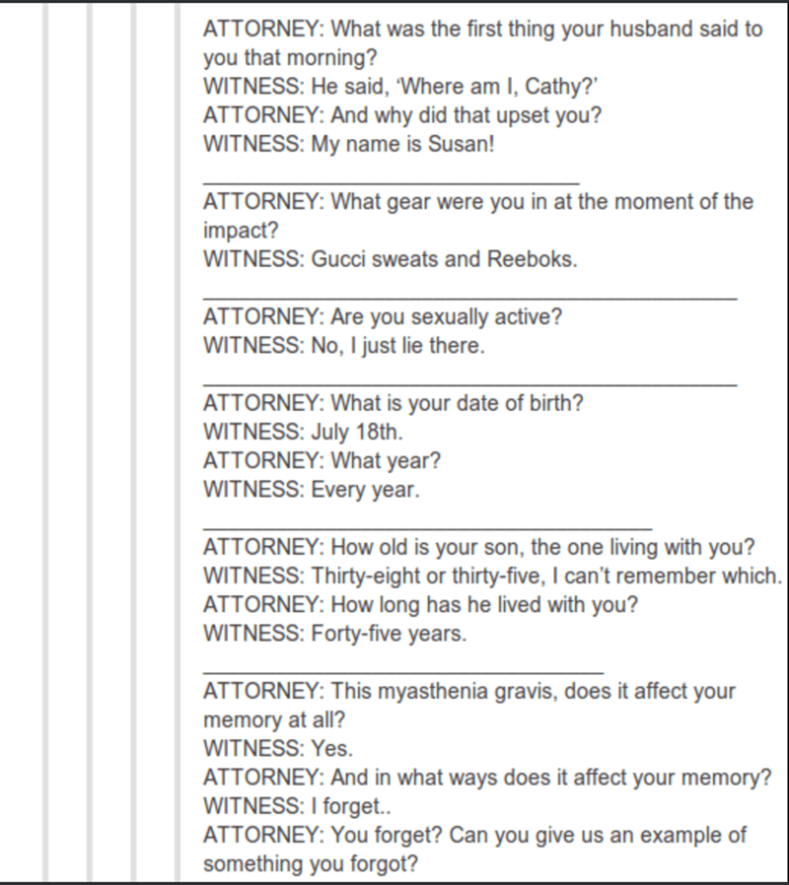

Slide 17
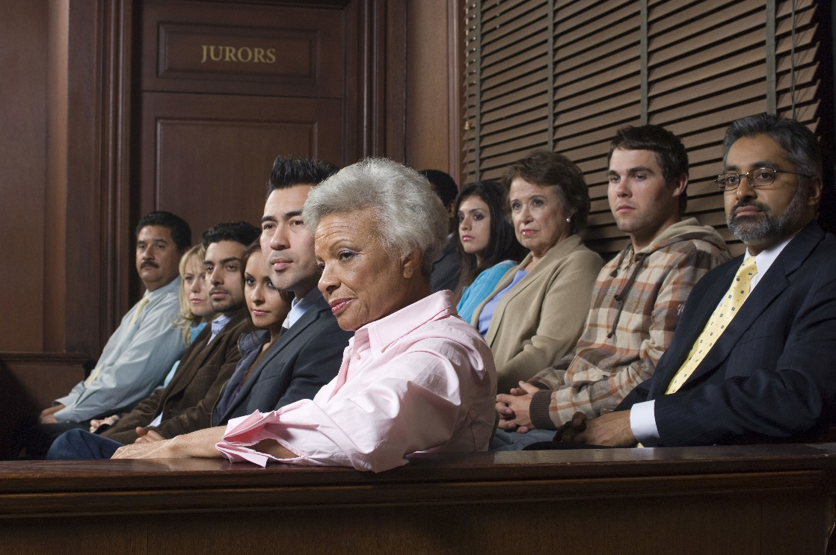
Jury Instructions
Jury instruction conferences
DCC has a stock instructions, use them.
Stipulate to jury instructions
Jury instructions due 7 days before trial
Be prepared
Don’t waste time

Slide 18


